Slide 1
Strategic Plan VFW Post 12215 Rancho Murieta
21 NOVEMBER 2024

Slide 2
Brief History of the VFW
The Veterans of Foreign Wars of the United States is a nonprofit veterans service organization comprised of eligible veterans and military service members from the active, guard and reserve forces.
We trace our roots back to 1899 when veterans of the Spanish-American War (1898) and the Philippine Insurrection (1899-1902) founded local organizations to secure rights and benefits for their service. Many arrived home wounded or sick. There was no medical care or veterans' pension for them, and they were left to care for themselves.
In their misery, some of these veterans banded together and formed organizations that would eventually band together and become known as the Veterans of Foreign Wars of the United States. After chapters were formed in Ohio, Colorado and Pennsylvania, the movement quickly gained momentum. Today, membership stands at more than 1.4 million members of the VFW and its Auxiliary.
Our voice was instrumental in establishing the Veterans Administration, development of the national cemetery system, in the fight for compensation for Vietnam vets exposed to Agent Orange and for veterans diagnosed with Gulf War Syndrome. In 2008, we won a long-fought victory with the passing of a GI Bill for the 21st Century, giving expanded educational benefits to America's active duty service members, and members of the guard and reserves, fighting in Iraq and Afghanistan. We were the driving force behind the Veterans Access and Accountability Act of 2014, and continually fight for improved VA medical centers services for women veterans. The VFW's legislative advocacy efforts were also the driving force behind the passage of the 2019 Blue Water Navy Veteran Act, and the passage of the 2022 Honoring Our PACT Act, which the VFW considers one of the most significant pieces of veterans legislation in history.
Besides helping fund the creation of the Vietnam, Korean War, World War II and Women in Military Service memorials, in 2005 the VFW became the first veterans' organization to contribute to building the new Disabled Veterans for Life Memorial, which opened in November 2010. And in 2015, we became the first supporter of the Desert Storm and Desert Shield Memorial which broke ground in July of 2022.

Slide 3
Post Mission
To foster camaraderie among United States veterans of overseas conflicts. To advocate for and serve all veterans, the military and our communities.

Slide 4
Post Vision
Ensure that our local veterans are respected for their service, always receive their earned entitlements, and are recognized for the sacrifices they and their loved ones have made on behalf of this great nation.

Slide 5
Core Values
Always put the interests of our members first
Treat donors as partners in our cause
Promote patriotism
Honor military service
Ensure the care of veterans and their families
Serve our community
Promote a positive image of the VFW
Respect the diversity of veteran opinions

Slide 6
Goals for CY2025 (Jan-Dec 2025)
Achieve a 5% increase in membership by December 2025
Develop and publish a Post budget that aligns with Post Goals/objectives and accounts for all Post requirements
Increase fundraising activities to generate revenue above our requirement to sustain annual Post activities
Engage with community and local leaders to increase support to our post and demonstrate value to our community
Develop and sustain a social event schedule that promotes camaraderie and supports our members and the community

Slide 7
Tactics to Achieve our Goals
1. Increased Post Membership (15%)
Conduct quarterly membership drive events
“Recruit a Member” Campaign
Provide appealing events, topics, subjects, speakers etc… at meetings
Advertise and advocate for our Post throughout the community
2. Increase Fundraising to generate revenue beyond Post requirements
Conduct at least two large fundraisers per year
Conduct community events throughout the year
Solicit community partners/donors
3. Develop and sustain a social event schedule
Assign committee chair to generate social calendar
Publish long range social calendar
4. Develop and Publish Post Budget
Receive committee spend plans
Consolidate spend plans
Present and publish Post budget
5. Increased community engagement
Research, develop and publish community engagement opportunities

Slide 8
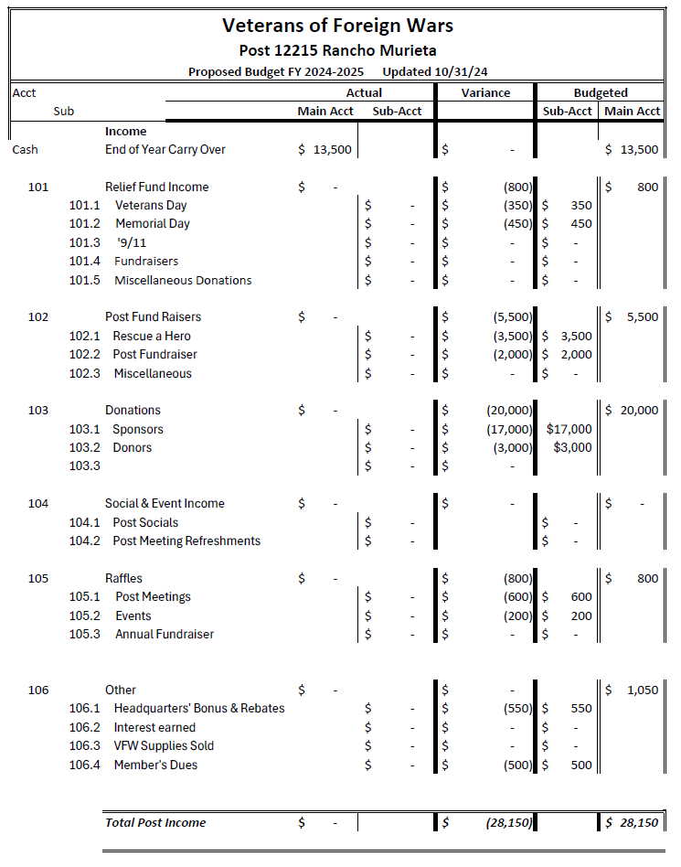
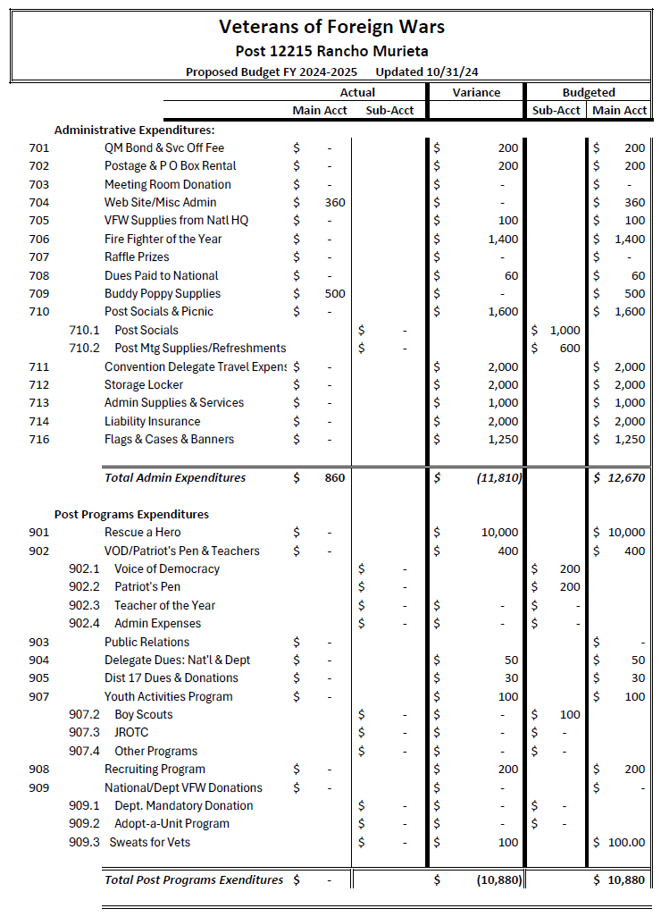
Post Budget

Slide 9
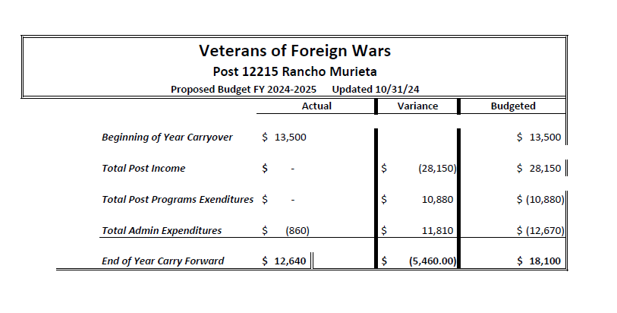
Post Budget

Slide 10
Post Long Range Calendar
FY 2025
1st Qtr
2nd Qtr
3rd Qtr
4th Qtr
JUL
AUG
SEP
OCT
NOV
DEC
JAN
FEB
MAR
APR
MAY
JUN
Mo
Mtg
Mo
Mtg
Mo
Mtg
Mo
Mtg
Mo
Mtg
Mo
Mtg
Mo
Mtg
Mo
Mtg
Mo
Mtg
Mo
Mtg
Mo
Mtg
Qtrly
Rep
Qtrly
Rep
Qtrly
Rep
Qtrly
Rep
Mem
Drive
Mem
Drive
Mem
Drive
Poppy
Drive
Ann
Budget
Fund
Raise
Social
Fund
Raise
Social
Social

Slide 11
Post Short Range Calendar
November 2024
Sun | Mon | Tue | Wed | Thu | Fri | Sat
 |  |  |  |  | 1 | 2
3 | 4 | 5 | 6 | 7 | 8 | 9
10 | 11 | 12 | 13 | 14 | 15 | 16
17 | 18 | 19 | 20 | 21 | 22 | 23
24 | 25 | 26 | 27 | 28 | 29 | 30
Mo
Mtg

Slide 12
Post Short Range Calendar
December 2024
Sun | Mon | Tue | Wed | Thu | Fri | Sat
1 | 2 | 3 | 4 | 5 | 6 | 7
8 | 9 | 10 | 11 | 12 | 13 | 14
15 | 16 | 17 | 18 | 19 | 20 | 21
22 | 23 | 24 | 25 | 26 | 27 | 28
29 | 30 | 31
Mo
Mtg

Slide 13
Post Short Range Calendar
January 2025
Sun | Mon | Tue | Wed | Thu | Fri | Sat
 |  |  | 1 | 2 | 3 | 4
5 | 6 | 7 | 8 | 9 | 10 | 11
12 | 13 | 14 | 15 | 16 | 17 | 18
19 | 20 | 21 | 22 | 23 | 24 | 25
26 | 27 | 28 | 29 | 30 | 31
Mo
Mtg

Slide 14
Comments/Dialogue

